Slide 1
NextHikes IT Solutions Bike Sharing Demand Analysis Project Using Excel
- Presented by Parul Srivastava

Slide 2
Comparison of original vs processed dataset 1
Steps Taken in Data Processing
Renaming Columns for Clarity
Technical column names like hr, temp, weathersit were renamed to Hour, Temperature, WeatherCondition, etc.
Date Conversion
Converted Excel serial date (dteday) to standard date format (DD/MM/YYYY).
Extracted Year, Month, Day, and MonthName from the date.
Time Categorization
Mapped Hour to TimeOfDay (e.g., 0–5 = Night, 6–11 = Morning, etc.).
Weather Mapping
Translated weathersit codes to descriptive labels in WeatherCondition.
Holiday and Weekday Interpretation
Used Holiday and Weekday flags to derive DateType and WeekdayName.
Temperature Categorization
Grouped temperature values into TempCategory (e.g., Cold < 0.2, Mild 0.2–0.4, Warm > 0.4).
Week of Year Calculation
Computed WeekOfYear from the date for time-series analysis.
Data Enrichment
Added derived columns like Len(Hr) to indicate hourly intervals.
Feature | Original Dataset | Processed Dataset
Column Names | Short, technical (e.g., hr, temp) | Descriptive and user-friendly (e.g., Hour, Temperature)
Date Format | Numeric (dteday as serial number) | Human-readable (Date in DD/MM/YYYY format)
Time Context | Only hour (hr) | Added TimeOfDay (e.g., Morning, Afternoon)
Weather Info | Coded (weathersit) | Mapped to WeatherCondition (e.g., Clear, Cloudy)
Holiday & Weekday | Numeric flags | Converted to DateType (e.g., Holiday, Working Day) and WeekdayName
Temperature | Numeric (0–1 scale) | Preserved but categorized into TempCategory (e.g., Cold, Mild, Warm)
Date Components | Not split | Extracted into Year, Month, Day, MonthName, WeekOfYear
Length of Hour | Not present | Added Len(Hr) for hourly granularity

Slide 3
Comparison of original vs processed dataset 2
Step | Original Dataset | Processed Dataset | Description
1. Column Renaming | Generic column names like atemp, hum, cnt | Descriptive names like Feels_like_Temp, Humidity_pct (%), cnt (Total Rentals) | Improves clarity and interpretability
2. Feature Engineering | Raw features only | New columns like Casual Ratio, Registered Ratio, casual_to_registered_ratio, Humidity_Level, Windspeed_Values | Derived metrics to enrich analysis
3. Data Formatting | Decimal values with inconsistent precision | Rounded or standardized decimal formatting | Enhances consistency and readability
4. Unit Conversion | Raw values (e.g., windspeed) | Converted units (e.g., Windspeed_km/hr) | Makes data more interpretable and usable
5. Categorical Mapping | No categorical labels | Added labels like Humidity_Level, RentalType | Enables classification and segmentation
6. Data Cleaning | Some missing or zero values | Likely handled or flagged (e.g., zero rentals) | Improves data quality for modeling
7. Indexing | Implicit row index | Explicit instant column retained | Maintains temporal order for time series analysis
Summary of Processing Steps Taken
Renamed Columns for better understanding (e.g., hum → Humidity_pct (%))
Created New Features:
Casual Ratio = Casual / Total Rentals
Registered Ratio = Registered / Total Rentals
casual_to_registered_ratio = Casual / Registered
Converted Units:
Windspeed to Windspeed_km/hr
Mapped Categorical Levels:
Humidity_Level based on humidity ranges
RentalType inferred from rental behavior
Standardized Numeric Precision for consistency
Handled Missing or Zero Values (e.g., zero rentals flagged or filtered)
Preserved Temporal Index using instant for time-based analysis

Slide 4
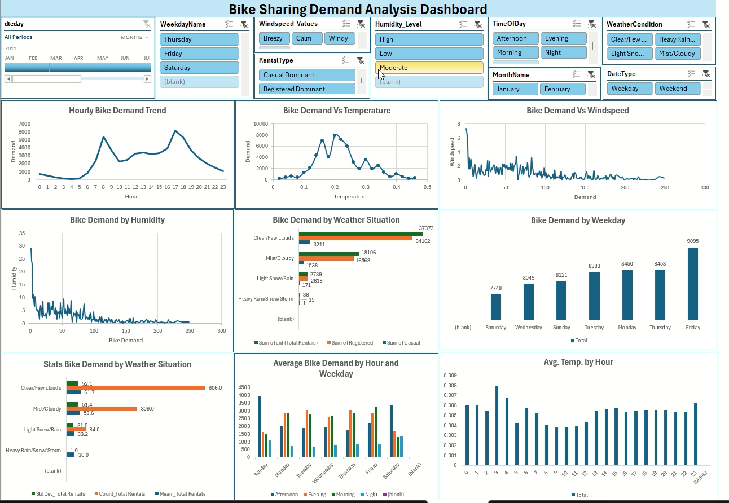
Note: Use play button to review the recording of the dashboard

Slide 5
Demand Vs Humidity
Insight: High humidity slightly reduces demand
Recommendation:
Offer hydration stations or cooling stops
Use app notifications to suggest optimal ride times

Slide 6
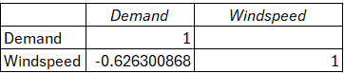
Demand Vs Windspeed
Correlation Matrix
Insight: Slight negative correlation (-0.626); higher wind reduces demand
Recommendation:
Provide wind protection gear
Monitor wind forecasts to adjust fleet deployment

Slide 7
Demand Vs Temperature
Insight: Positive correlation; warmer days attract more riders
Recommendation:
Promote rides during mild weather
Offer cooling accessories or shaded routes during hot days

Slide 8
Hourly Demand Trend
Insight: Peaks around 8 AM and 6 PM, indicating commute times
Recommendation:
Ensure bike availability during peak hours
Offer incentives for off-peak usage to balance demand

Slide 9
Bike Demand by Weekday
Insight: Weekdays show consistent demand; weekends may vary
Recommendation:
Target weekday commuters with subscription plans
Promote leisure rides on weekends with family packages

Slide 10
Bike Demand by Weather Situation
Insight: Clear weather has the highest demand; poor weather (rain/snow) significantly reduces usage
Recommendation:
Improve rain gear availability or offer weather-protected bikes
Consider dynamic pricing based on weather conditions

Slide 11
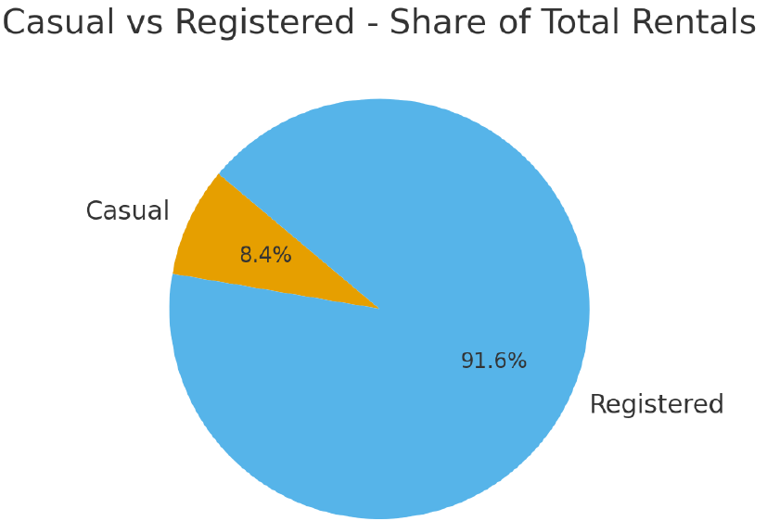
Casual vs Registered - Share
• Insight: Registered users account for 91.6% of rides. Registered users dominate usage
Recommendation:
Convert casual users with loyalty programs
Provide exclusive benefits to registered users to retain them

Slide 12
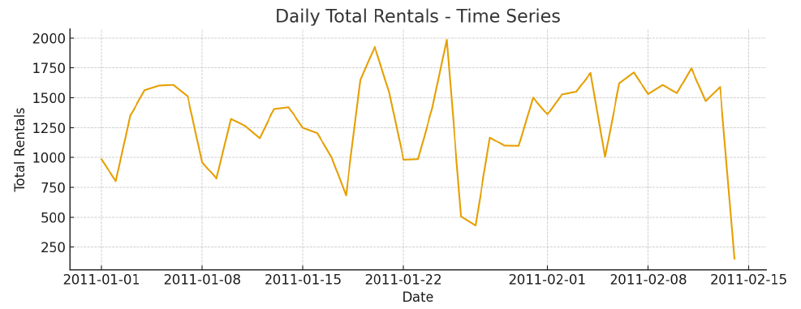
Daily Total Rentals - Time Series
• Trend: clear seasonality with peaks in certain months.
• Recommendation: allocate more bikes/staff during peak months and run targeted promotions in low months.

Slide 13
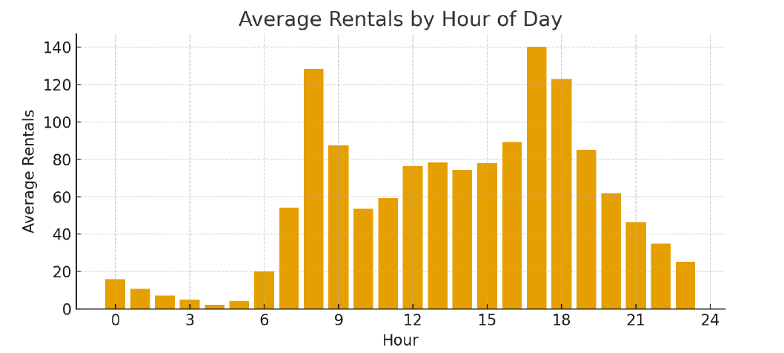
Average Rentals by Hour
• Peak demand during morning commute and evening hours.
• Recommendation: adjust redistribution schedules to ensure availability during peak hours

Slide 14
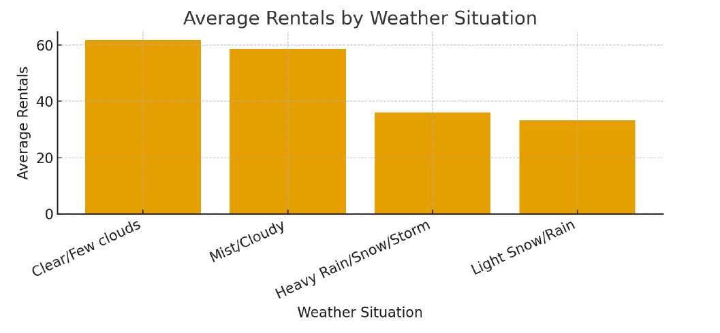
Average Rentals by Weather Situation
• Clear weather yields highest rentals; heavy rain/storms drastically reduce usage.
• Recommendation: implement weather-triggered communications and dynamic incentives

Slide 15
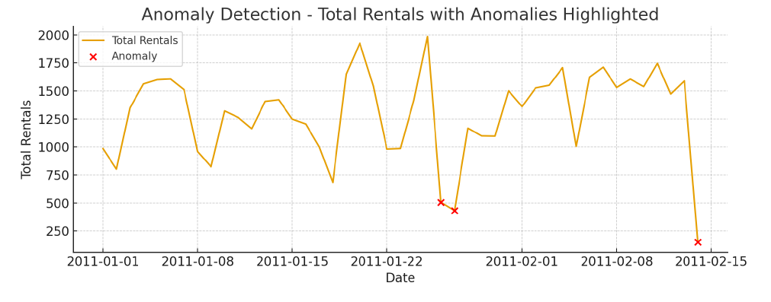
Anomaly Detection - Highlighted Days
• Anomalies flagged correspond to sudden drops/spikes possibly due to events or data issues.
• Recommendation: investigate flagged dates; cross-check with external events & data collection logs.

Slide 16
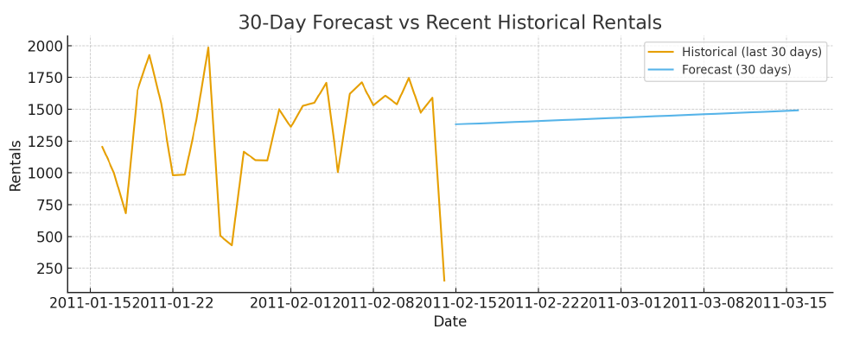
30-Day Forecast vs Recent Historical
• Forecast indicates slight upward trend in short term.
• Recommendation: use forecast for staffing and inventory planning; update model with new data monthly.

Slide 17
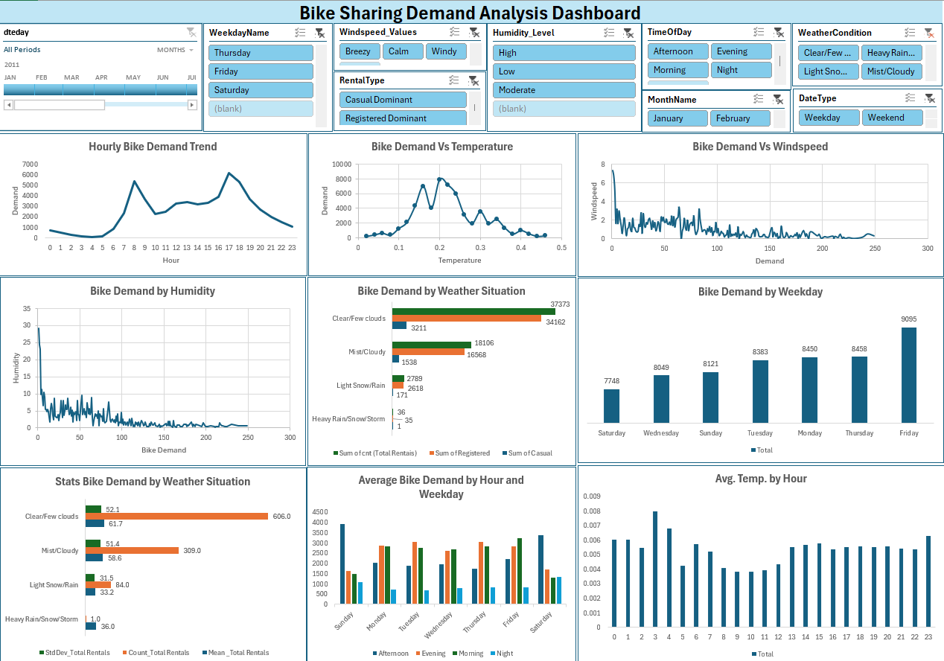

Slide 18
Key Insights
Daily rentals (time series): Clear seasonality with identifiable high- and low-demand months. Operational capacity should reflect these cycles.
Hourly demand: Distinct morning and evening peaks — matches commuting patterns. Redistribution & bike rebalancing must target these hours.
Seasonal effect: Summer shows the highest average rentals; winter the lowest. Consider seasonal promotions and maintenance windows in low season.
Weather impact: Clear/fair weather yields highest usage; heavy rain/storm reduces rentals sharply. Weather-aware nudges or incentives can help.
Casual vs Registered: Registered users constitute the majority of rides (detailed % in the deck). Converting casual users increases lifetime value; run targeted membership offers.
Anomalies: Several dates flagged as anomalies (spikes/dips). Investigate event calendars / holiday logs / data collection problems for those dates.
30-day forecast: Short-term forecast shows a modest upward trend; use it for near-term staffing and inventory planning.

Slide 19
Top Recommendations
1. Demand-driven allocation: Increase bike availability during peak hours and summer months.
2. Convert casual users: Offer targeted subscription incentives and in-app promotions.
3. Weather-aware operations: Push notifications & dynamic pricing on favorable days.
4. Investigate anomalies: Verify external causes (events, holidays) or data collection errors.
5. Forecast integration: Incorporate forecast into weekly operational planning and staffing.

Slide 20
Thank You…

